Slide 1
Paying Your FFA Dues
On Katy ISD Pay N Go

Slide 2

1. Go to Katy ISD Pay N Go Website

Slide 3

2. Click Jordan HS

Slide 4
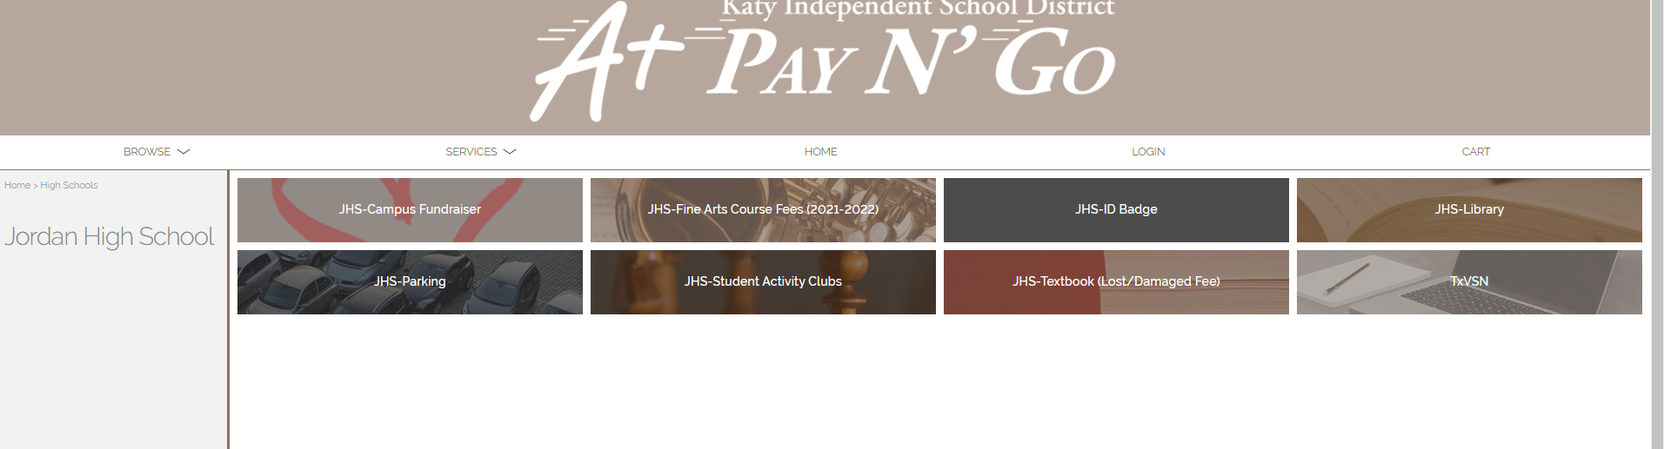
3. Click “JHS- Student Activity Clubs”

Slide 5

4. Click “JHS- Agricultural Science/FFA”

Slide 6
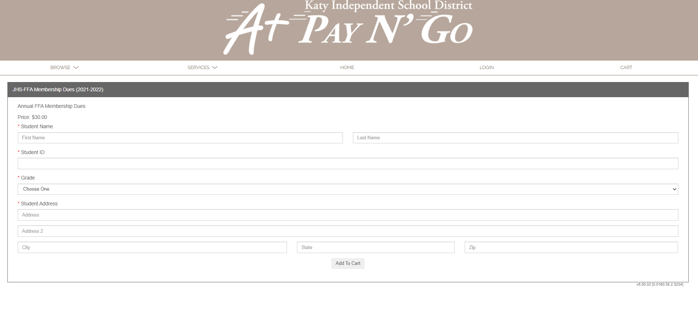
5. Complete the Information & Checkout

